Slide 1

How to use Unity

Slide 2
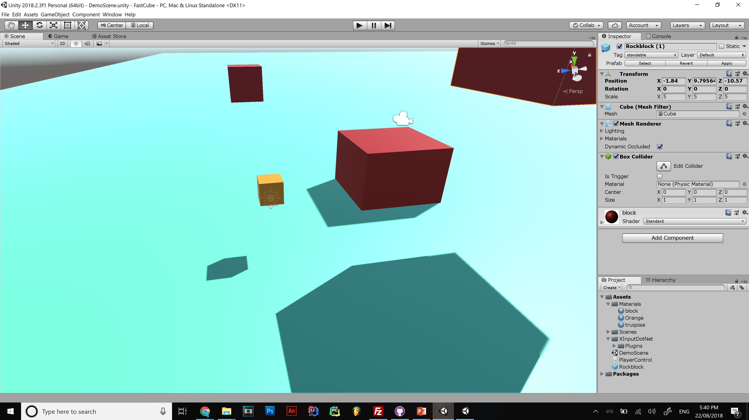

Game feel
Notes:
Assets folder is in the root of the project folder put all your stuff in there!!
Be organised and put scripts in Assets/Scripts , materials in Assets/Materials etc,,

Slide 3
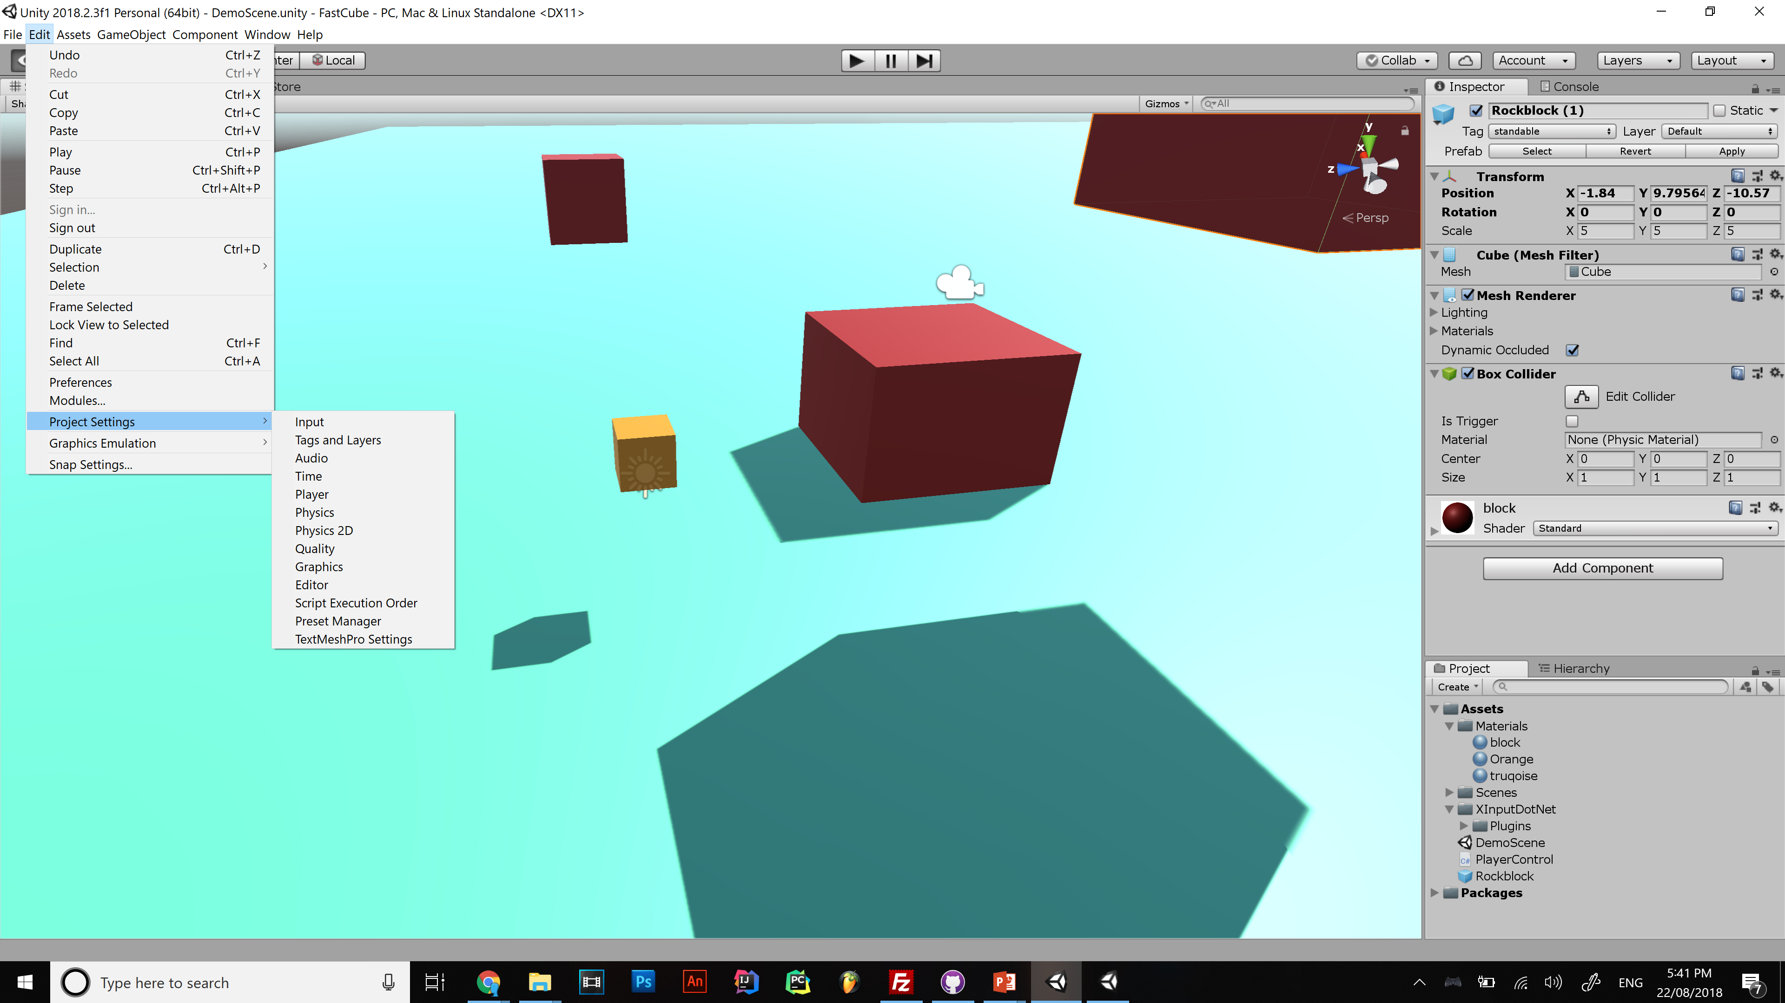

Slide 4
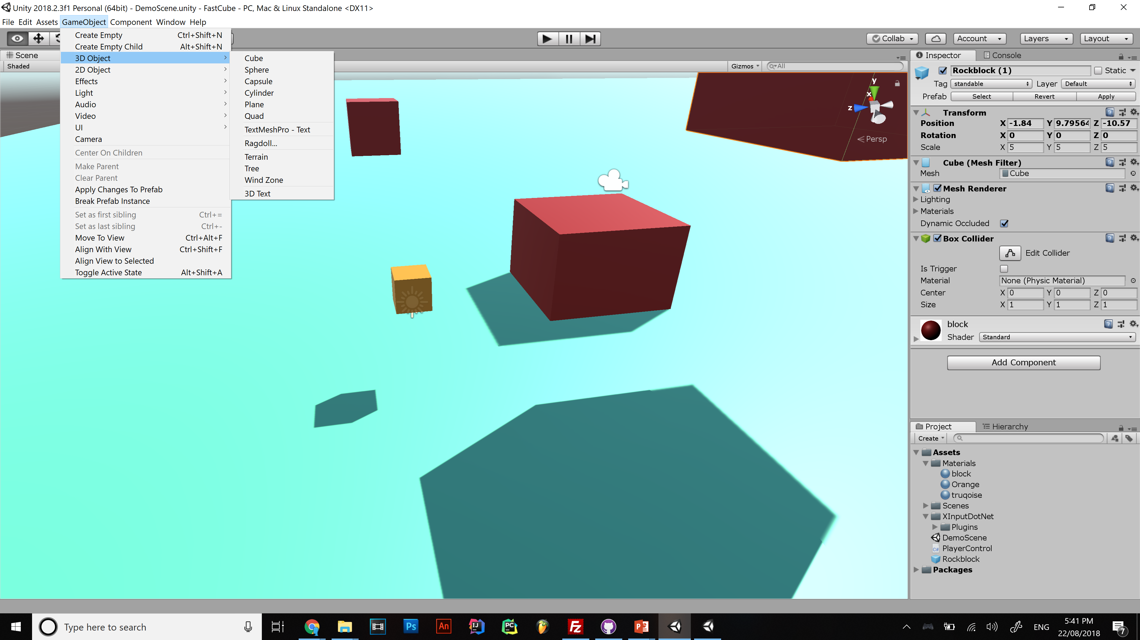

Slide 5
Unity organises games into scenes
Level 1
Main Menu
Level 2
Credits

Slide 6
Components

Slide 7
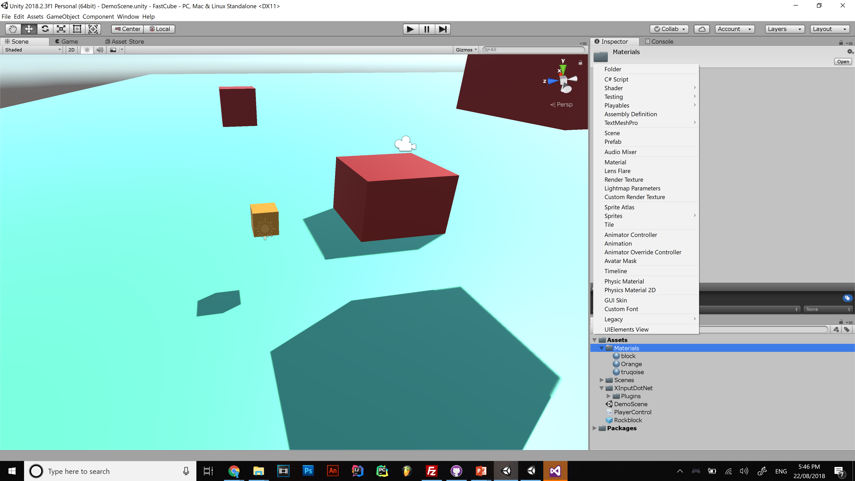

Slide 8
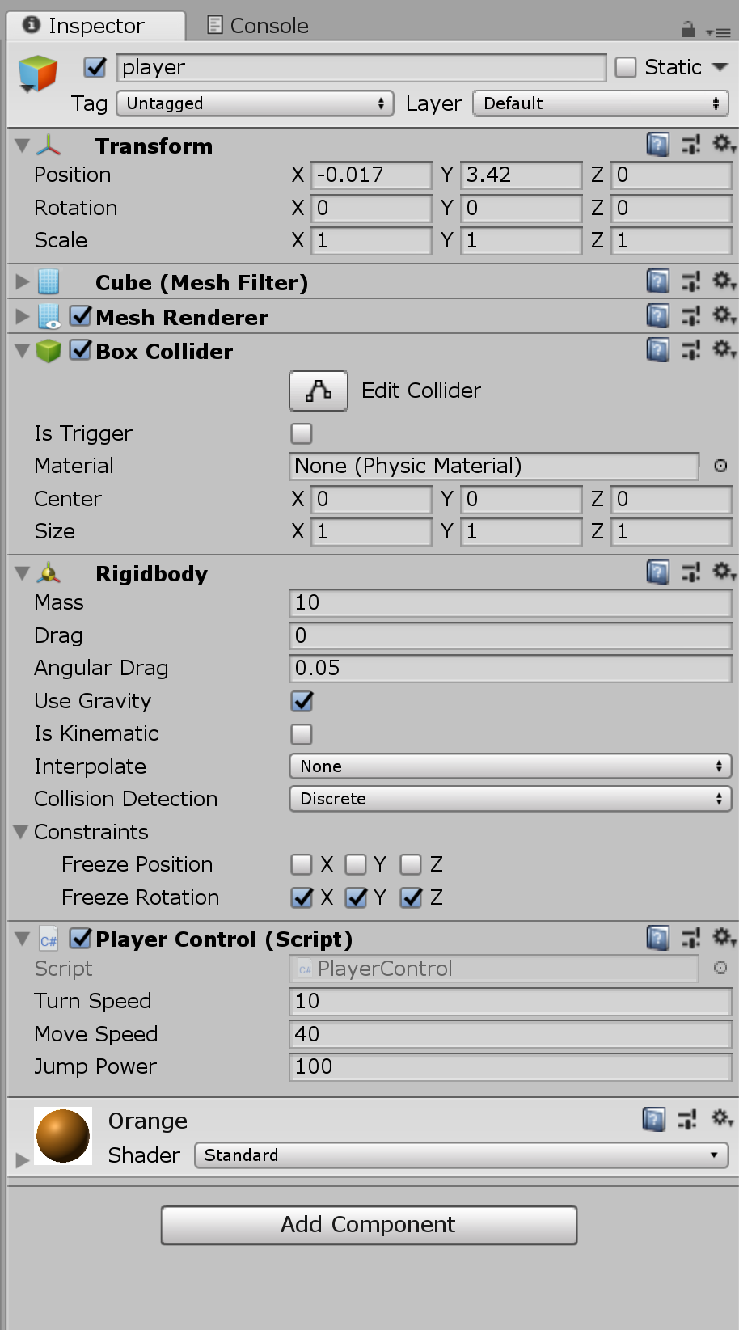
Unity is Game objects and engine settings
Game Objects
Transform
Mesh
Renderer
Components
Materials
Scripts
Physics
Collider
Animations
Audio
etc
Public variables

Slide 9
Separate your mechanics into your objects
Coin objects have a script that gives the player object one coin and disappears
Put menu controls on a object on the canvas
Player controls on player object

Slide 10
If you understand all that you’re ready to code
Kinda..
Now install visual studio
DO YOU NEED PHYSICS? (probably)
Rigid body/Collider
Which you can get for free because you are a student

Slide 11
I like visual studio but you can also use any IDE you like

Slide 12
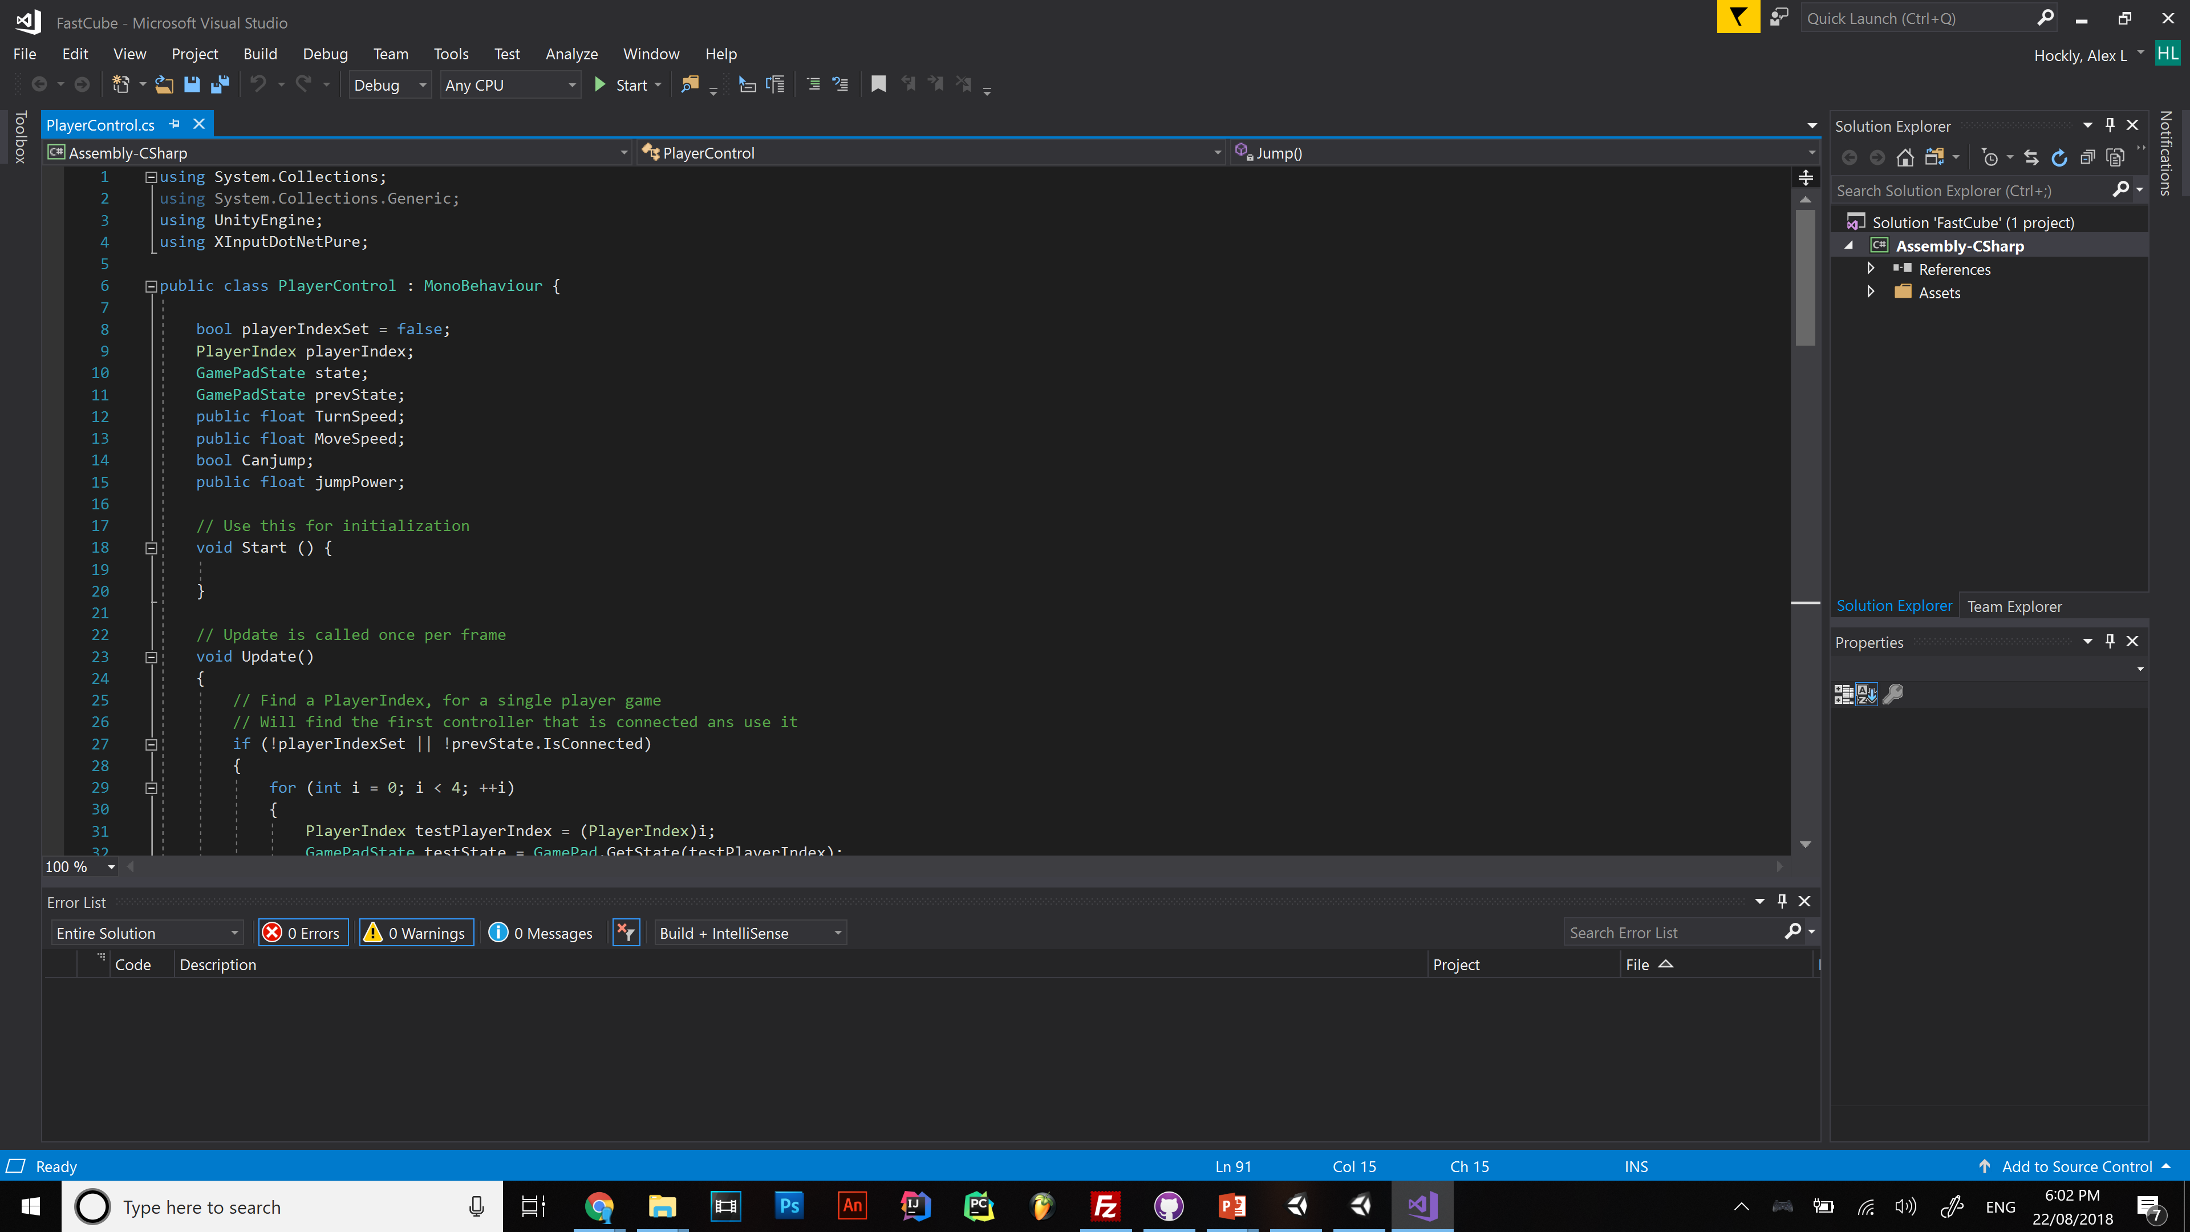
Notes:
UI breakdown

Slide 13
Look out for outdated info!! If a forum post is more than 3 years old avoid it

Slide 14
Unity documentation
https://docs.unity3d.com/ScriptReference/Transform.html

Slide 15
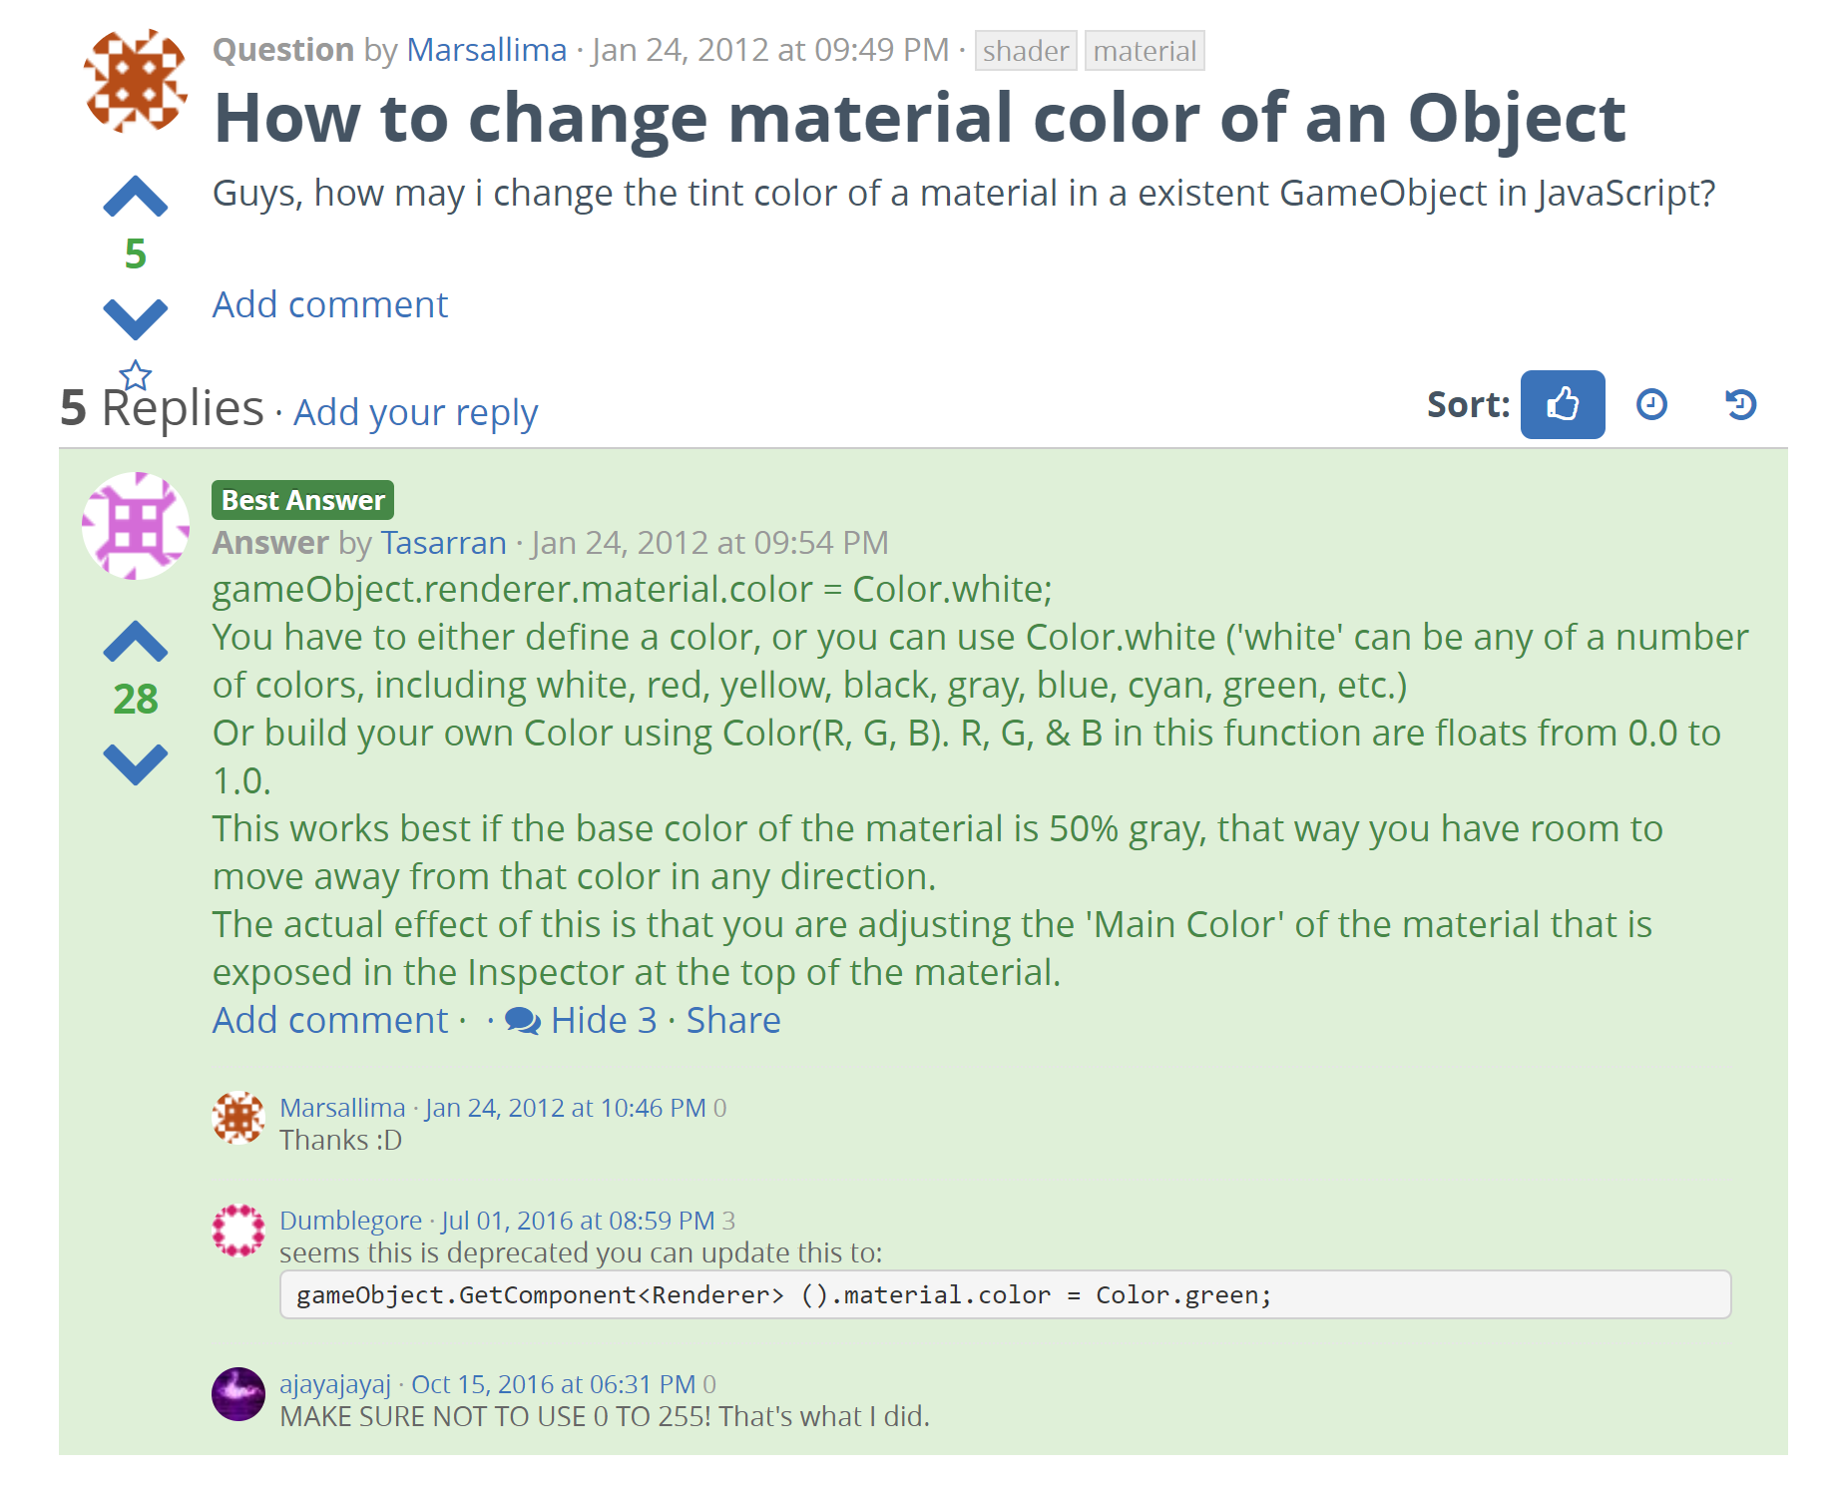
https://answers.unity.com/questions/209573/how-to-change-material-color-of-an-object.html

Slide 16
Code Flow
Continuous and real-time
Frame are made as fast as hardware allows
Update is called 120 times a second at 120fps and 30 time a second at 30fps
DO NOT put a infinite loop in the update function

Slide 17
Making things happen
Void Start{
public float speed;
RigidBody rigbdy = gameObject.GetComponent<Rigid Body>();
}
Void Update{
rigbdy.AddForce(transform.forward * speed);
}

Slide 18
Realtime things
using UnityEngine;
using System.Collections; public class WaitForSecondsExample : MonoBehaviour {
public float cooldown = 5f;
void Start() {
StartCoroutine(Example());
} IEnumerator Example() {
canAttack=false;
yield return new WaitForSecondsRealtime(cooldown);
canAttack=true;
}
}

Slide 19
void OnCollisionEnter(Collision collision)
{
if (collision.gameObject.tag == "standable") {
Canjump = true;
}
if (collision.gameObject.tag == "death") {
living = false;
}
if (collision.gameObject.tag == "collectable") {
Destroy(collision.gameObject);
Score++;
}
}
void OnCollisionExit(Collision collision) {
if (collision.gameObject.tag == "standable") {
Canjump = false;
}
}

Slide 20
Some more unity concepts
Prefabs
Primitive geometry
Tags
.unityPackage

Slide 21
Next time
Vector3()

